Slide 1

SoC Platform
㈜ 상화 마이크로텍
Version 1.6

Slide 2


프레젠테이션의 목적
상화 마이크로텍의 SoC 개발 플랫폼과 S/W등의 Solution base의 개발 환경을 제시하여 Customer의 원활한 이해와 빠른 개발을 도모하고자 함.

Slide 3

AGENDA
Who is Sanghwa ?
Sanghwa’s SoC Solution
SoC Core Roadmap
ARM based Design process
Simulation Platform
Design Simulation Environment
Sangwha ARM Verification Env.
Deliverables

Slide 4
Who is Sanghwa ?
Beginning Stage
Jan 1997 Established Sanghwa Micro Technology Inc (SMT).
Jul 1997 Registered ASICXpress™ as Trademark
Dec 1997 Made Pro-ASIC Design Center agreement with Zycad (US)
Mar 1998 Made Korea ASIC Design Center agreement with VLSI(US)
Growth Stage
Aug 1999 Made agreement as Artisan Service Net Program
Member of Korea
May 2000 Registered as the official partners related to
ASIC with Samsung Electronics and Samsung SDI
Jun 2000 Opened and got certificate for semiconductor
technology research center
Jun 2001 Made the agreement with LEDA System as
IP Business Partner in Korea
Sep 2002 Made DCA (Design Center Alliance) agreement
with TSMC (Taiwan)
Dec 2003 Listed on KOSDAQ
1997
1999~
2004~
Leaping Stage
Jan 2004 Made ATAP Design Partnership agreement with ARM (UK)
Jul 2005 Moved to the new Office
Mar 2006 Start SoC Level – 1 Business

Slide 5


Sanghwa’s SoC Solution
SoC의 하드웨어 설계 능력 뿐만 아니라 Operating System 및 Firmware의 작성 능력 및 지원능력을 보유하여 Customer에게 가장 적합한 Solution을 제공할 수 있슴.
R&D Div 2 (SoC)
SoC Design
Platform
Software
Multimedia
Communication
Image processing
ARM Platform
Top Simulation
Linux
WinCE
RT/OS
Firmware
Middle ware

Slide 6
Sanghwa’s SoC Solution
SoC
  Project
    Have experience more than 10 Embedded CPU projects
  Experienced CPU Architecture design
  Experienced mobile application processor design
    2 Projects
  SoC Mass production
    More than 8 projects

Slide 7
Sanghwa’s SoC Solution - S/W
Experienced porting various O/S to own designed SoC
Linux / Windows CE / Embedded or OnChip RT/OS
Experienced building Rich featured F/W Layer on many platform and
CPU architecture
07’1Q
S-RT/OS
On-Chip RT/OS
06’3Q
RT/OS
06’4Q
Linux
07’2Q
WinCE 5.0

Slide 8



SoC Core Roadmap
ARM11-MPCore
ARM9-922T
ARM9-926EJ-S
ARM9-946E-S
ARM7-720T
ARM7TDMI
2004
2005
2006
2007

Slide 9



SoC Core Chip Roadmap-ZETA Series
Will be release only contracted customer
Will be available end of 4Q/2006
1
2
3
ZETA-7H
ZETA-9H
ZETA-9A
ARM7 TDMI
AMBA AHB
AMBA APB
Peripherals
ARM9
AMBA AHB
AMBA APB
Peripherals
ARM9
AMBA AXI
AMBA APB
Peripherals

Slide 10
Sanghwa AXI Builder
Sangwha AXI Builder
Support AMBA 3.0 specification
Support multi-master and multi slave
Easily configurable architecture
Will be release End of 3Q
Will be proven on silicon

Slide 11
ARM based Design process
SAS
( Sangwha ARM Simulation
Platform )
RTL Design /
Simulation
SAV
(Sangwha ARM verification Platform)
Physical Verification
Physical ARM
Insertion
Synthesize /
Test Insertion
SDF / DSM
STA
Foundry

Slide 12
Simulation Platform
To aid understanding of the ARM simulation environment
To aid building of the ARM simulation environment
  AMBA Simulation platform
    Script based simulation environment
    AHB Protocol
  Core Simulation Platform
    Core simulation model
    C source executable environments

Slide 13
Design Simulation Environment
Operating System
- Solaris
- Linux
Simulator
- Cadence : NC-SIM
- Synopsys : VCS
- Mentor : ModelSim

Slide 14
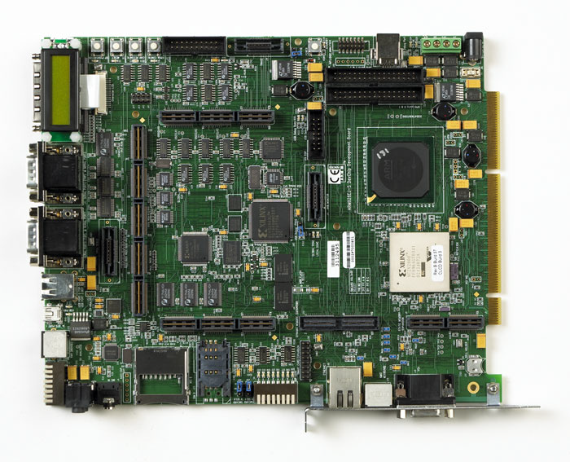
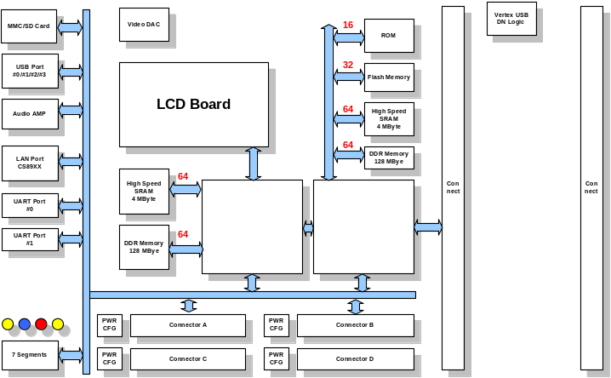
Sanghwa ARM Verification Env.
SAV -A
- ARM Integration B/D
- Operating Systems
. Linux . WinCE . RT/OS
- GCC based development environment
SAV-F
- FPGA Based Integration board
- Sangwha FPGA based Integration B/D
- Will be release end of 2Q

Slide 15
Sanghwa ARM Verification Env.
 | SAV-F1 | SAV-F2/4
Major Feature | CoreTile/ZETA Core Xilinx V4LX200 * 1 | CoreTile/ZETA Core Xilinx V4LX200 * 2/4
Support | Will be dependent on contract | Will be dependent on contract
NOTE | Will be deliverable end of 2Q ZETA version will be available end of 4Q’2006 | Will be available end of 2Q Will be deliverable end of 3Q ZETA version will be available end of 4Q’2006

Slide 16
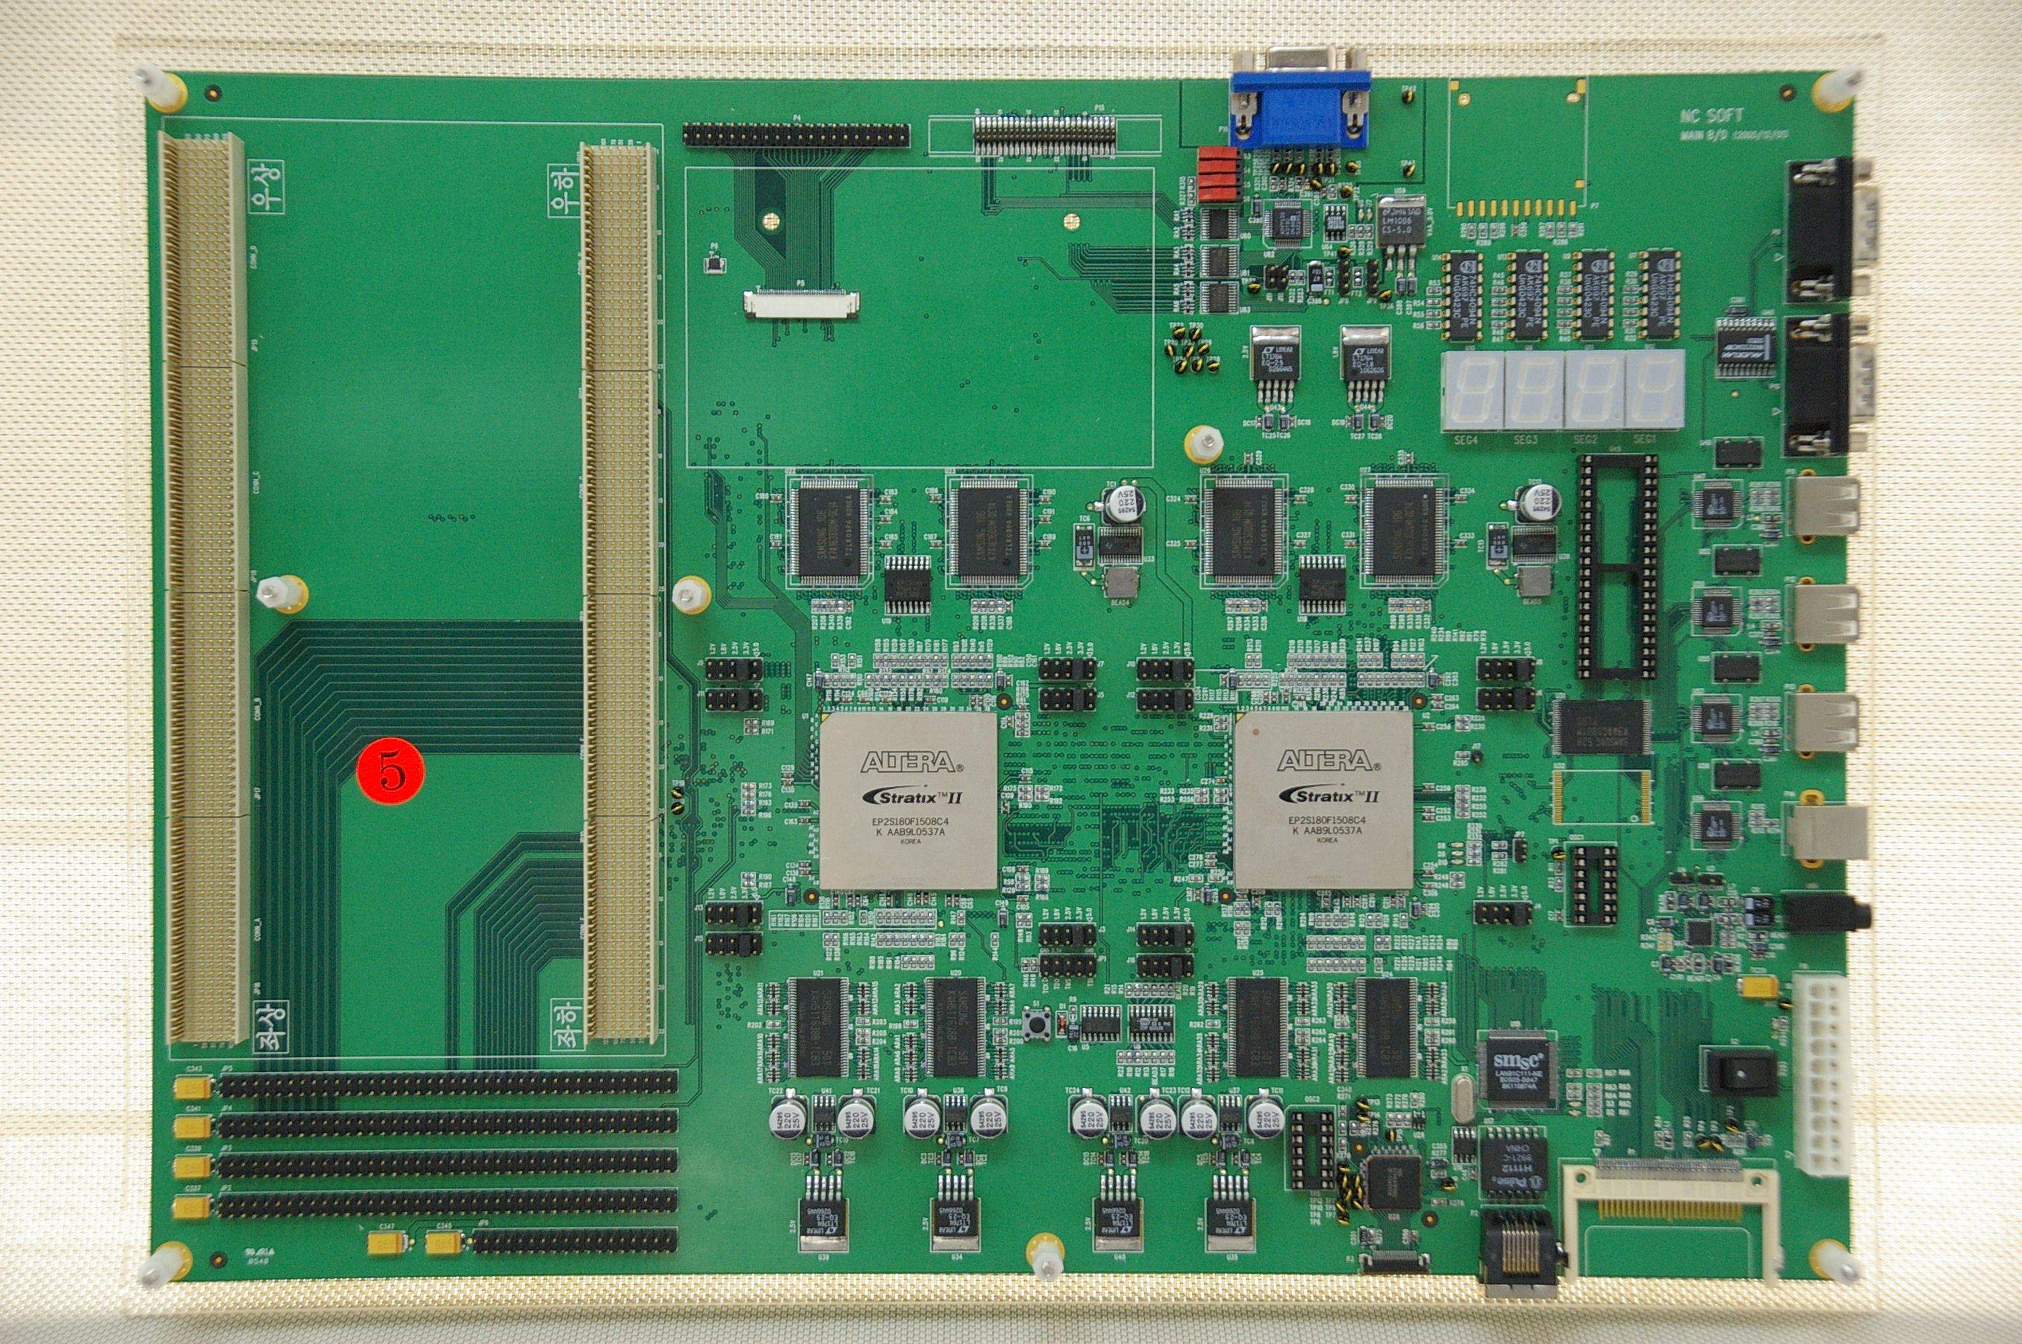

Slide 17
ARM IP List
Name | Status | Available | NOTE
UART | Completed | Available | PrimeCell
TIMER | Completed | Available | PrimeCell
PIC | Completed | Available | PrimeCell
Synchronous Static Memory Controller | Completed | Available | PrimeCell
Static Memory Controller | Completed | Available | PrimeCell
SDRAM Controller | Completed | Available | PrimeCell
DDR Controller | Planned | End of 3Q’06 | Designe by Sanghwa
Keyboard/Mouse I/F | Completed | Available | PrimeCell
Multiple Bus Master DMA | Completed | Available | PrimeCell
Single AHB Master DMA | Completed | Available | PrimeCell
Colour LCD Controller | Completed | Available | PrimeCell
64 Colour LCD Controller | Completed | Available | PrimeCell
Multi-Port Memory Controller | Completed | Available | PrimeCell
64 bit Multi-Port Memory Controller | Completed | Available | PrimeCell
Vectored Interrupt Controller | Completed | Available | PrimeCell
Advanced Vectored Interrupt Controller | Completed | Available | PrimeCell
External Bus Interface | Completed | Available | PrimeCell
S-AXI | Design | End of 3Q’06 | Design by Sanghwa
SDRAM Controller for AXI | Design | End of 3Q’06 | Design by Sanghwa
DMA Controller for AXI | Design | End of 3Q’06 | Design by Sanghwa
AXI2AHB | Design | End of 3Q’06 | Design by Sanghwa
AXI2APB | Design | End of 3Q’06 | Design by Sanghwa

Slide 18
Deliverables
Customized SAS
  Simulation example scripts
  The example AMBA SoC
    ARM 7 / 9
Customized SAV
  Dependent on contract
  SAV-A or SAV-F
Related documents
  Release note
  Technical Reference manual
  Design Kit User Guide

Slide 19

Discussion

Slide 20
Contact Point
연구 2팀장 : 임 종윤 수석
jylim@shmt.co.kr
02-2142-1742
연구 소장 : 김현균 이사
hkkim@shmt.co.kr
02-2142-1745
사업 총괄 : 홍 현석 상무
hshong@shmt.co.kr
02-2142-1720

Slide 21
Document history
Version 1.0 06/01/01 Created
Version 1.1 06/02/21 Added discussion pages
Added simulation platform
Version 1.2 06/03/03 Added S-AXI Generator
Version 1.3 06/03/08 Added SoC Team introduce materials
Version 1.4 06/03/28 Added FPGA Verification env and ZETA Series…
Separated SoC H/W and S/W issues
Version 1.5 06/03/31 Added PrimeCell and In-House designed IP Lists
Version 1.6 06/04/05 Removed expired licensed PrimeCell Lib
Added In-House design IP Lists

